Slide 1
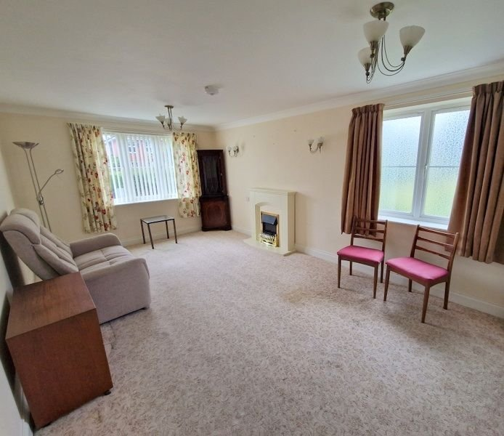
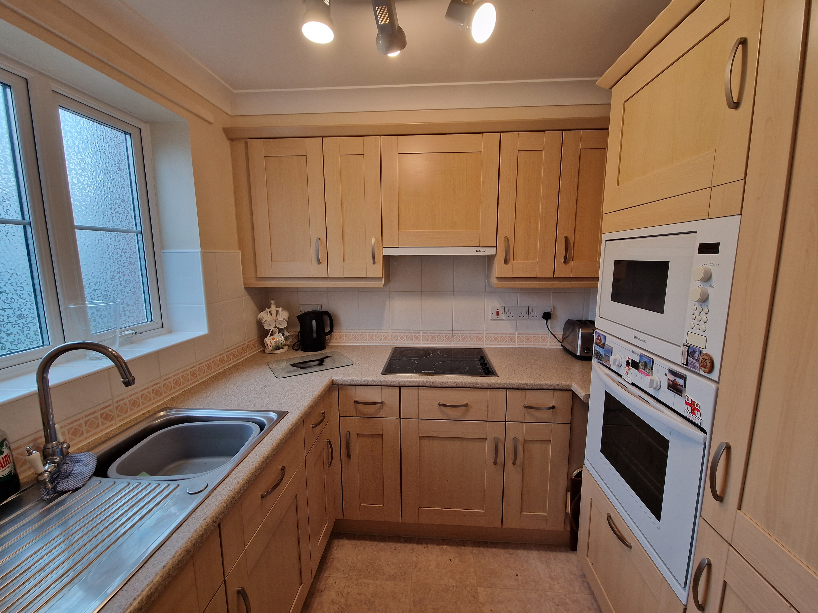
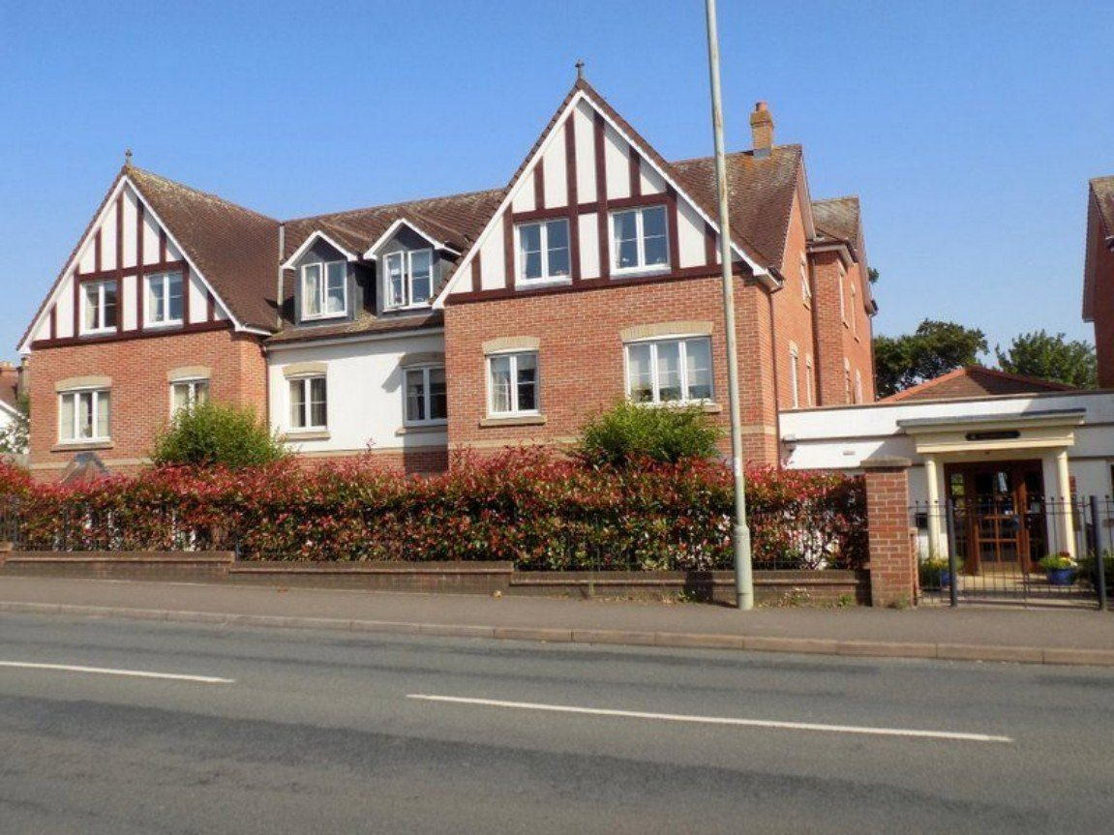
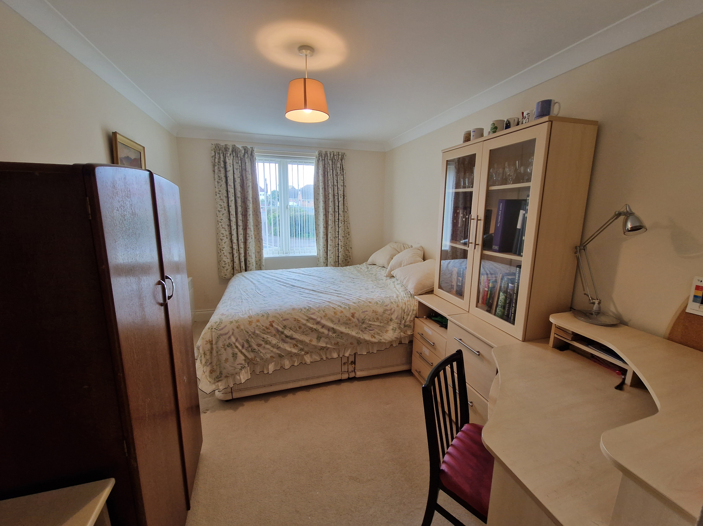
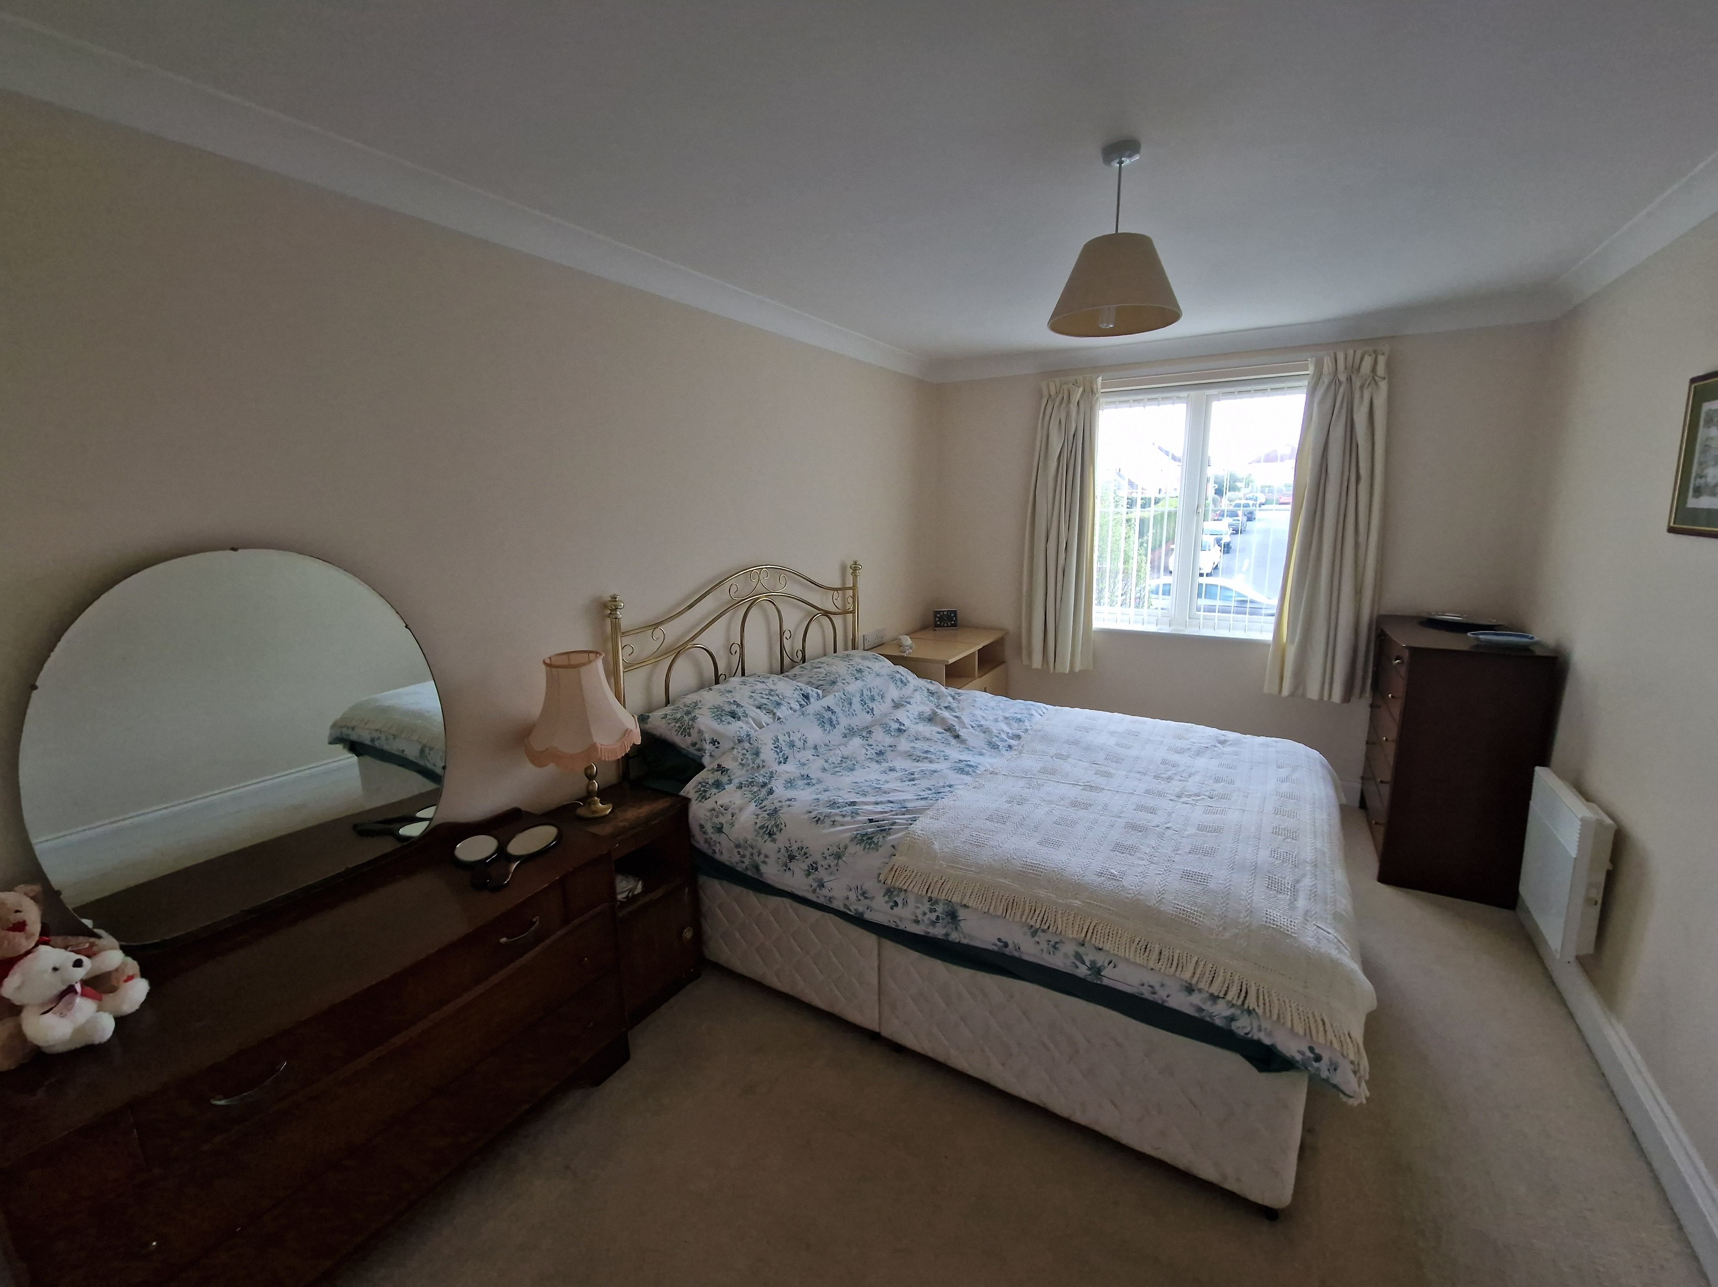
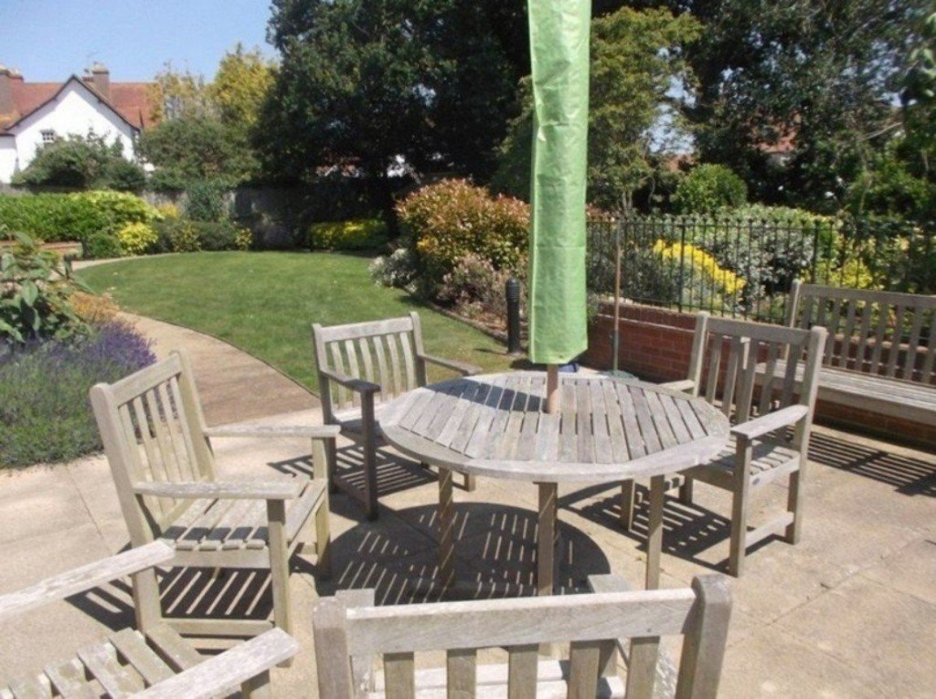
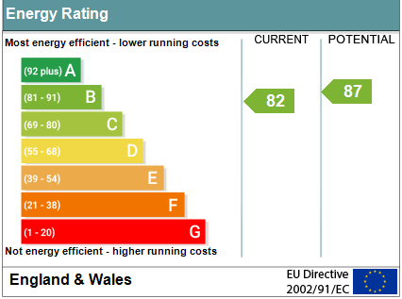
www.pennys.net
34 Pegasus Court, Salterton Road, Exmouth, EX8 2NN
PRICE £165,000
TENURE Leasehold
A Two Bedroom Retirement Apartment Located On The First Floor Of A Most Favoured Retirement Development Close To Local Bus Routes, Shops And Supermarkets
First Floor Retirement Apartment • Dual Aspect Lounge/Dining Room •
Fitted Kitchen With Integrated Appliances • Two Bedrooms •
Spacious Bathroom With Bath And Separate Shower Cubicle •
Secure Gated Parking Area • Development Manager And Care Line Support •
Delightful Well Tendered Communal Grounds • 125 Year Lease From 2008 •
Pennys Estate Agents Limited for themselves and for the vendor of this property whose agents they are give notice that:- (1) These particulars do not constitute any part of an offer or a contract. (2) All statements contained in these particulars are made without responsibility on the part of Pennys Estate Agents Limited. (3) None of the statements contained in these particulars are to be relied upon as a statement or representation of fact. (4) Any intending purchaser must satisfy himself/herself by inspection or otherwise as to the correctness of each of the statements contained in these particulars. (5) The vendor does not make or give and neither do Pennys Estate Agents Limited nor any person in their employment has any authority to make or give any representation or warranty whatever in relation to this property.
PENNYS ESTATE AGENTS
2 Rolle House, Rolle Street, Exmouth, Devon, EX8 2SN
Tel: 01395 264111 EMail: help@pennys.net

Slide 2
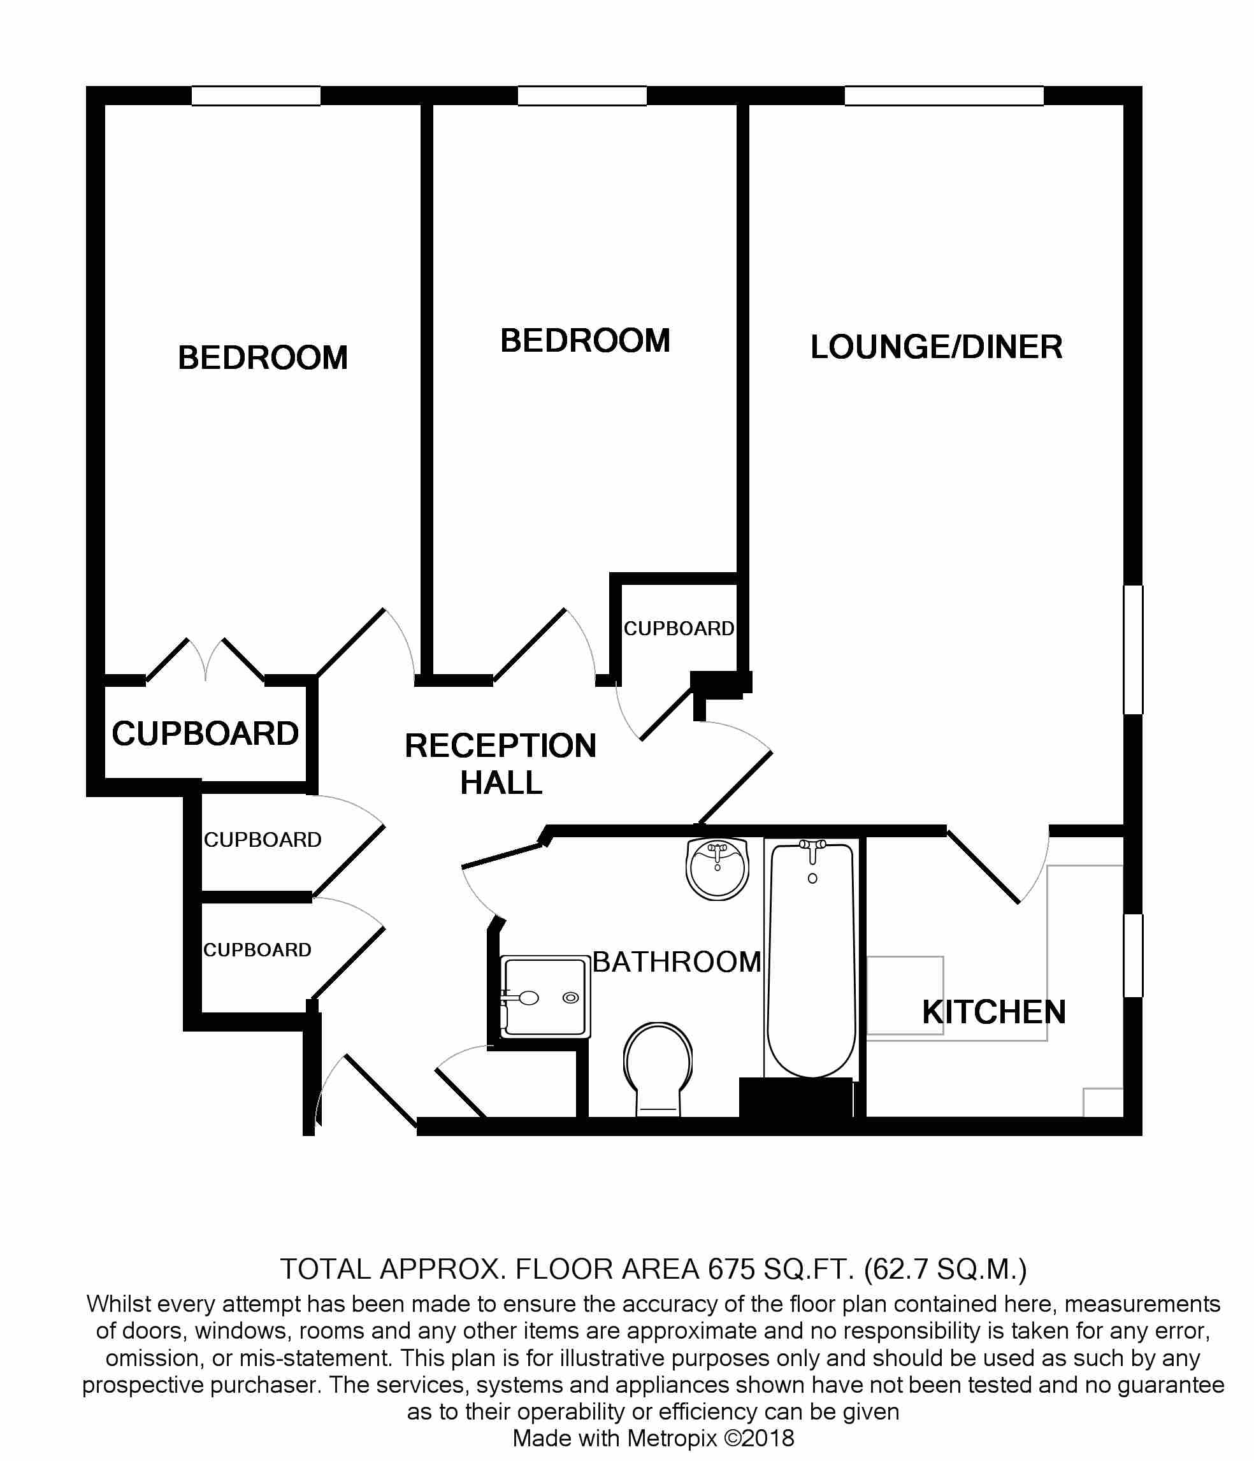
34 Pegasus Court, Salterton Road, Exmouth, EX8 2NN
Pegasus Court is a modern retirement development built with quality and elegance immediately evident. The attention to detail in communal areas as well as the apartment itself is worthy of special note. The kitchen is a superb feature of the property being fully equipped, well planned and designed. A clever carousel unit in the kitchen makes the most of the space, while the modern oven, hob, microwave and fridge/freezer are all built in. The taps in the kitchen and the fitted bathroom are easy to operate and hot water is available on demand from the economic heating system. In each room sockets are placed at waist height for greater convenience, and should assistance ever be needed, there are unobtrusive Careline units which can bring immediate response, coupled with the House Manager available from approximately 9am to 5pm, Monday to Friday. The parking area is accessed via electronic gates.
The communal areas are worthy of special note with a most attractive communal lounge, spacious laundry room, quality visitor suite, library and superb communal gardens. There is an age restriction on the development, and residents must be aged 60 years or over.
THE ACCOMODATION COMPRISES: Communal entrance door with remote entry system leading to communal areas with lift and staircase to the FIRST FLOOR. Own private front door with spy hole and letter box opening to:
RECEPTION HALL: A good size entrance to the property with remote entry system and alarm pull cord; coats cupboard with coat rack and shelving; cupboard housing water tank with slatted shelving over; built-in storage cupboard with light connected and housing the electric consumer unit and electric meter with shelf; further built-in shelved storage cupboard with light connected; coved ceiling; mains smoke detector; electric wall heater.
LOUNGE/DINING ROOM: 5.89m x 3.18m (19'4" x 10'5") A bright and spacious room with uPVC double glazed window to front elevation; further uPVC double glazed window with patterned glass; electric coal effect fire standing in attractive fire surround; television point; telephone point; two wall light points; two wall mounted electric heaters; glazed panelled door opening to:
KITCHEN: 2.31m x 1.93m (7'7" x 6'4") Fitted with a range of patterned work top surfaces with inset stainless single drainer sink unit with mixer tap over; range cupboards, drawer units, integrated fridge and freezer and built-in oven beneath work top surfaces; matching range of wall units at eye-level; inset four ring halogen hob with extractor hood over; tiled surrounds; coved ceiling; uPVC double glazed window with patterned glass to side elevation.
BEDROOM ONE: 4.24m x 2.77m (13'11" x 9'1") uPVC double glazed window to front elevation; electric wall heater; built-in wardrobe with clothes rail and shelving; coved ceiling.
BEDROOM TWO: 4.7m x 2.64m (15'5" x 8'8") reducing to 4' 2" (1.27m) in the doorway recess. uPVC double glazed window to front elevation; electric wall heater; coved ceiling.
BATHROOM/WC: Comprising bath with hand grips, shower attachment, shower curtain and rail; wash hand basin with display surface to either side with cupboards beneath and fitted mirror with display lighting over with matching cupboards to either side; WC with push button flush and display surface over; tiled shower cubicle with shower unit, shower tray, shower splash screen and shower splash screen door; fully tiled walls; heated towel rail; emergency care-line cord; coved ceiling and ceiling extractor fan.
OUTSIDE: The property benefits from attractive communal gardens to the rear of the development comprising of seating areas, attractive lawned gardens with colourful flowers and shrubs and patio sun terrace.
COMMUNAL FACILITIES: There is a spacious residents lounge with kitchenette and library area. A secured parking area with space subject to availability.
TENURE AND OUTGOINGS: We understand that the property is held on a 125 year lease from 1st August 2008. Service charges to be confirmed.
MORTGAGE ASSISTANCE: We are pleased to recommend Meredith Morgan Taylor, who would be pleased to help irrelevant of which estate agent you finally buy through. For a free initial, no obligation chat please contact us on 01395 264111 to arrange an appointment.
FLOOR PLAN:

